Slide 1
PHISHING AWARENESS TRAINING
Recognizing & Avoiding Phishing Attacks
Prepared by: Tamheed Tariq
Field: Cybersecurity Awareness
Date:11 - Jan - 2026

Slide 2
Training Objectives
After this training, you will be able to:
Understand what phishing is
Identify different types of phishing attacks
Recognize phishing emails, websites, and messages
Understand social engineering tactics
Learn how to avoid and respond to phishing attacks

Slide 3
What is Phishing?
Phishing is a cyber attack used to steal:
Usually delivered through:
Emails
Messages
Phone calls
Fake websites
Passwords
Bank details
Personal information
Attackers pretend to be trusted organizations

Slide 4
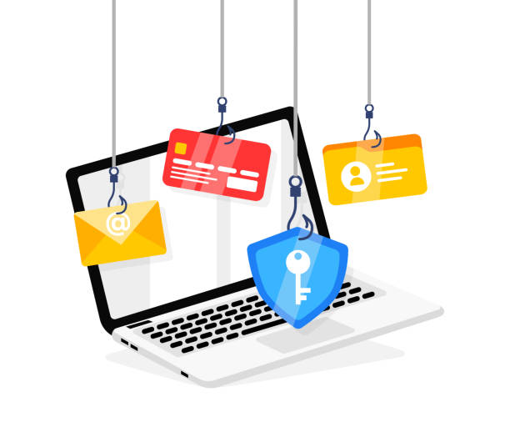
Why Phishing is Dangerous
Can lead to:
Financial loss
Identity theft
Account hacking
Data breaches
Most cyber attacks start with phishing
Even technical users can be tricked

Slide 5
Common Types of Phishing
Email Phishing
Smishing (SMS Phishing)
Vishing (Voice Phishing)
Website Phishing
Spear Phishing
Clone Phishing

Slide 6
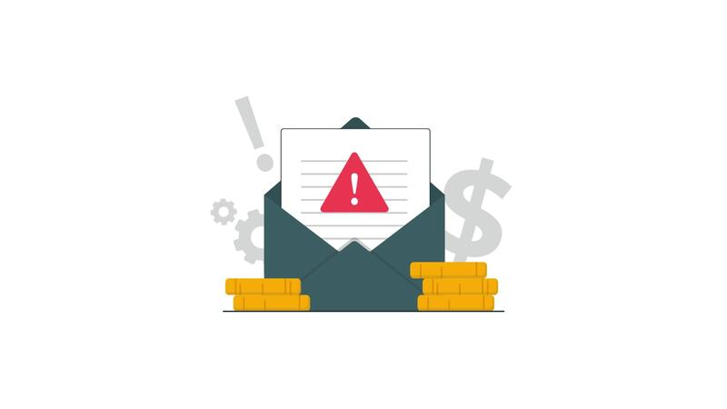
Email Phishing
Fake emails pretending to be from:
  Banks
  Companies
  Social media
Ask you to:
  Click a link
  Download an attachment
  Verify your account

Slide 7
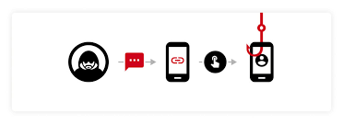
Smishing & Vishing
Smishing
  Phishing via SMS
  Fake prize, OTP, or delivery messages
Vishing
  Phishing via phone calls
  Fake support or bank representatives

Slide 8
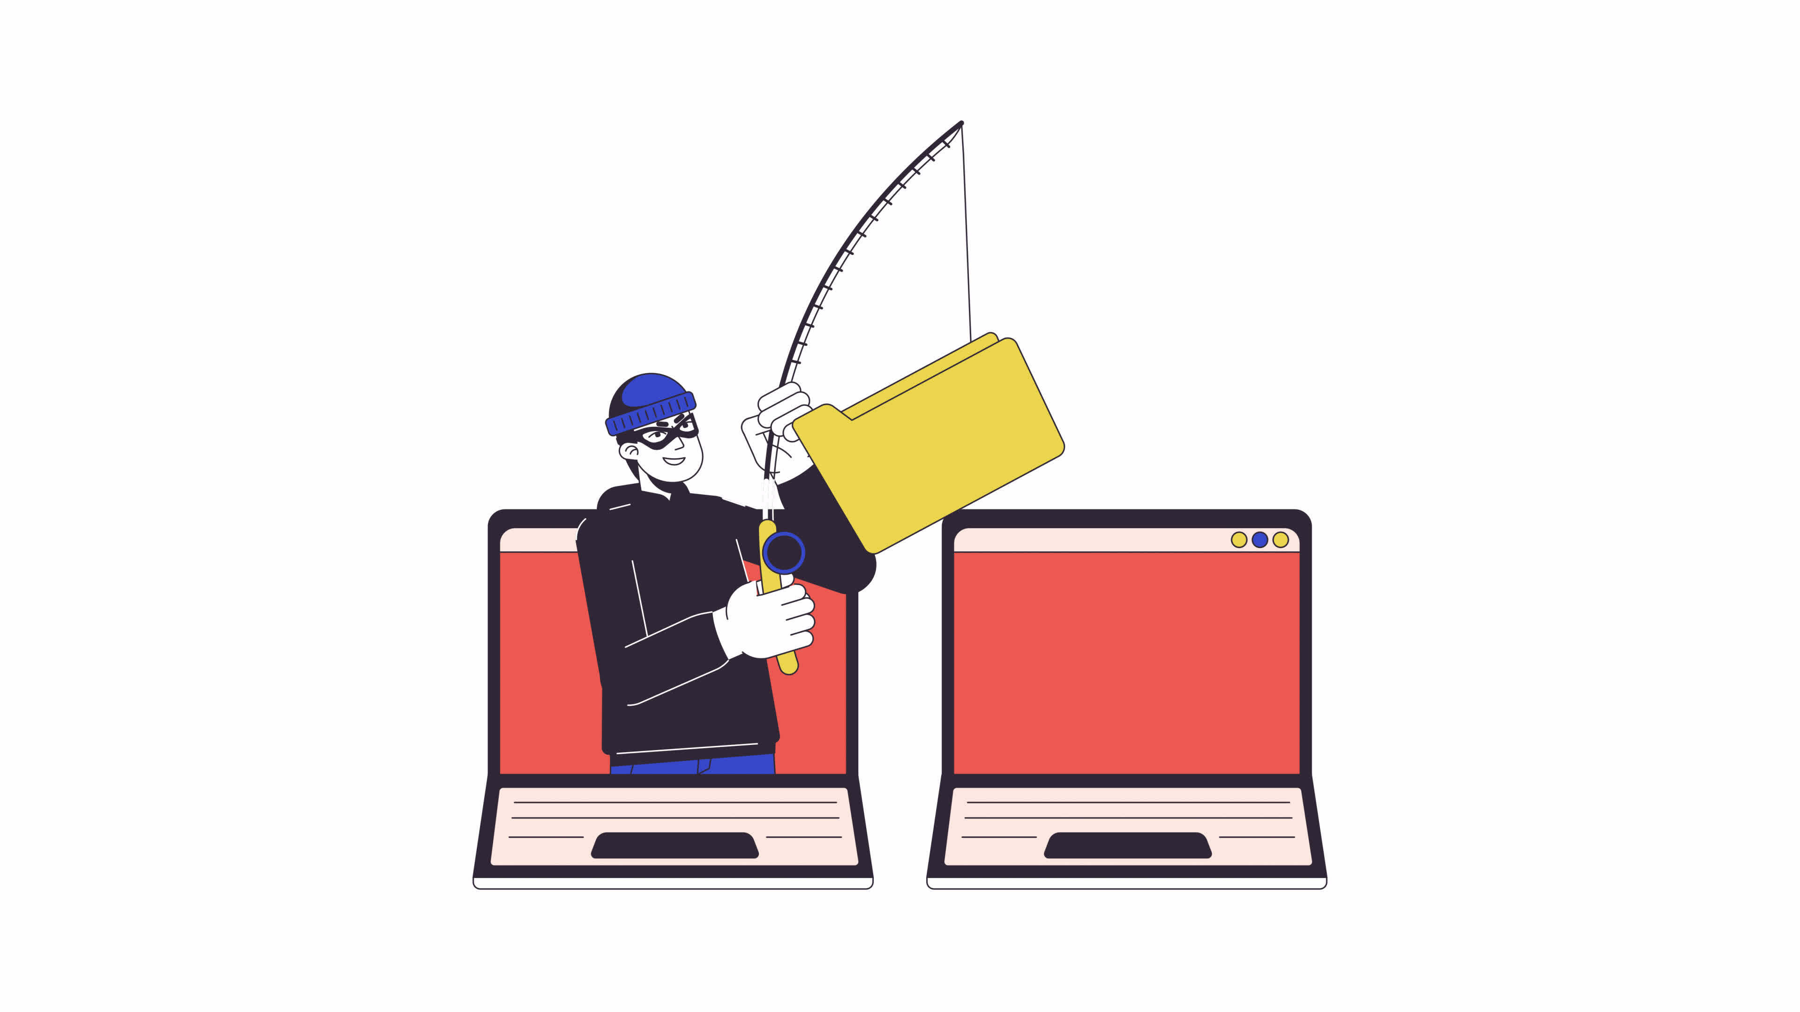
Website Phishing
Fake websites that look real
Designed to steal:
  Login credentials
  Credit card details
URLs may look similar but are fake
Example:
www.paypaI.com (I instead of L)

Slide 9
How Phishing Attacks Work
Attacker creates fake message/website
Victim receives email/message
Victim clicks link or enters data
Attacker steals information
Account or money is compromised

Slide 10
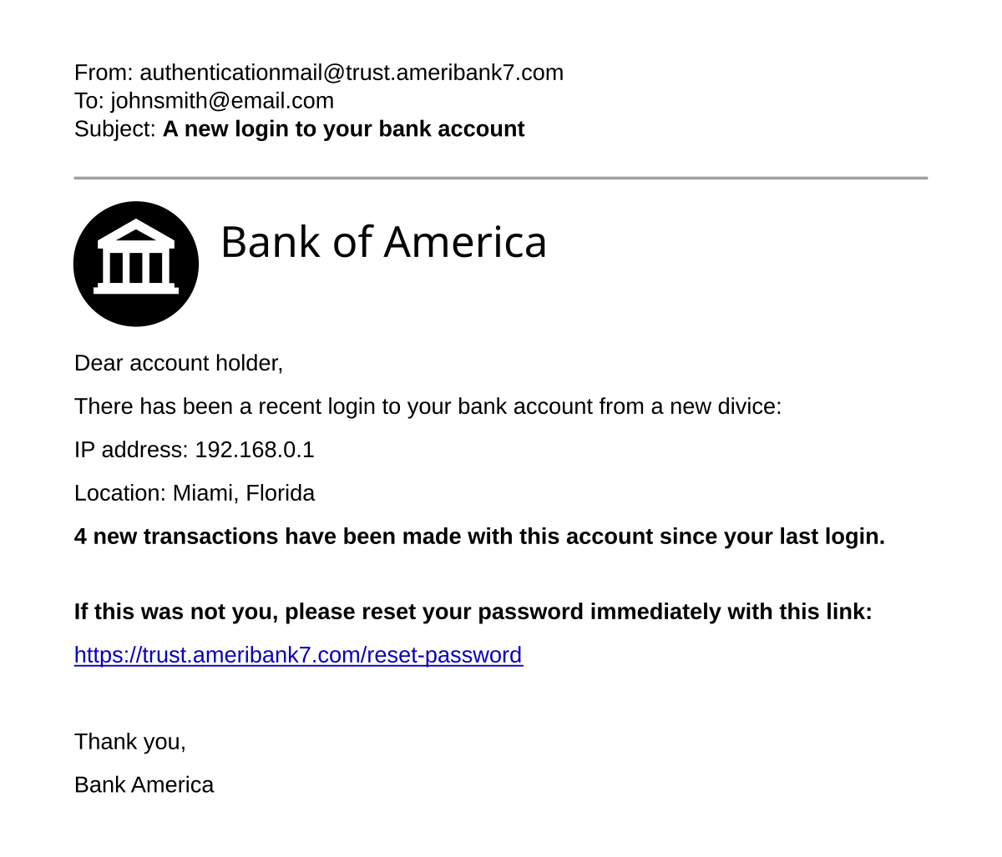
Real Phishing Email Example
Look for:
Fake sender email
Urgent message
Suspicious link
Grammar mistakes

Slide 11
Red Flags of Phishing Emails
Unknown sender
Urgent or threatening language
Spelling & grammar errors
Suspicious links
Requests for sensitive data

Slide 12
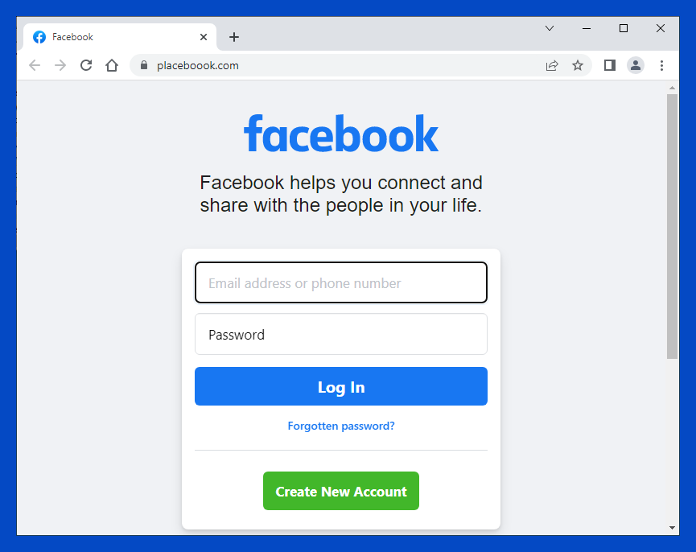
Identifying Fake Links
Hover over links to see real URL
Shortened links (bit.ly, tinyurl)
Misspelled domain names
HTTP instead of HTTPS

Slide 13

Social Engineering
Psychological manipulation
Attacker exploits:
  Fear
  Trust
  Urgency
  Curiosity
Used in most phishing attacks

Slide 14
Common Social Engineering Techniques
Fear (Account will be closed)
Urgency (Immediate action required)
Authority (Message from boss)
Reward (You won a prize)
Helpfulness (Fake support request)

Slide 15
How to Avoid Phishing
Verify sender identity
Do not click unknown links
Do not share passwords or OTPs
Use strong passwords
Enable 2-Factor Authentication

Slide 16
What To Do If You Receive a Phishing Message
Do NOT click links
Do NOT download attachments
Report the message
Delete it immediately
Inform IT or security team

Slide 17
What If You Are a Victim?
Change passwords immediately
Enable 2FA
Inform bank/company
Scan device for malware
Monitor accounts for suspicious activity

Slide 18
Short Quiz (Awareness Check)
Q1: Is it safe to click links in urgent emails?
Q2: What is smishing?
Q3: Name one phishing red flag

Slide 19
Key Takeaways
Phishing is a serious cyber threat
Always think before you click
Verify before trusting
Awareness is the best defense
One mistake can lead to big loss

Slide 20
Conclusion
Phishing attacks are increasing daily
Everyone is a target
Stay alert, stay secure
Cybersecurity starts with awareness

Slide 21
Thank You
Google Form Quiz Link ==>
https://docs.google.com/forms/d/e/1FAIpQLSc88JNf-4TXSZ3FxbLT3zc4SE5GcwR1qTfhpCKKKBrel6llBQ/viewform?usp=header

